Slide 1
Searching for Books and Journals -The basics of OPAC Search-
Nagoya University Central Library
Notes:
＜About content of note＞
No marks：flow of lecture and reminders
●：explain necessarily
○：explain if time allows
＜time allocation＞
・slide2-6（before OPAC search demonstration）：3mins
・slide7-13（Searching OPAC (books）demonstration, screen explanation）：5mins
・slide14（Practical exercise 1）：5mins
・slide15-17（arrangement of books）：2mins
・slide18-20（OPAC search (journals) demonstration, Screen explanation）：5mins
・slide 21(practical exercise 2)：5mins
・slide22-23（arrangement of journals）：2mins
・slide24（using materials）：1min
・slide25-26（If cannot find, troubled）：3mins
＜Things required for the lecture＞
・Printed notes of this presentation
・Journal to explain journals’ articles

Slide 2
Aims of this Training Course
Searching for materials
Learning how to search if needed materials are in the library
Finding materials
Finding out the location of materials
Using the materials
Learning the procedures to use the materials
When you need help
Learning where to ask help if you can not find the materials
Notes:
【Before starting guidance:
Ask participants if they have experience of searching books in OPAC.
→if all of them are experienced, explain slides 4-8 in a simple form】
【Explain the goal of the guidance】
●The goal of this workshop is so that you become able to find and use the books required by your class, which are available in the library.

Slide 3
About Nagoya University Library (NUL)
Central Library and departmental libraries are contained in NUL
There are around 3.4 million items of materials in NUL
1.3 million items held in Central Library
There are various types of materials too
The most important thing is to find out the location of materials needed
When you search for materials in Nagoya University Library:
1. First of all search in ‘OPAC’
2. Then ‘go to the bookshelves’
Notes:
【No need to explain content of each slide】
●There are many libraries (not only Central Library) in Nagoya University
●All the materials are separately stored in different departmental libraries.
In Central Library books are divided into even more specific places.
↓
●First of all, before going to the bookshelves, it is important to search if required materials are available in the library

Slide 4
Searching for Books in OPAC
Searching for textbooks and recommended books
Assigned books
Searching for the materials for reports
Books concerned about your topic
When you find a book
Scanning the book in order to grasp general content
Searching for the topic and reading thoroughly
Obtaining the clues for research ・・・index and references
Notes:
●There are two types of searching.
・Searching for assigned books (e.g. textbooks, recommended books)
・Searching for books concerned about your topic
○Reading tips
(Explain “When you find a book”)

Slide 5
What is OPAC？
OPAC
= Online Public Access Catalog
A tool for searching books and journals in Nagoya University Library
Notes:
●OPAC is a tool to search for materials available in NUL

Slide 6
Let’s Try to Use OPAC！
Library Homepage <https://www.nul.nagoya-u.ac.jp/index_e.html>
Notes:
【explain demonstrating】
●Link to OPAC is on top-page of the library web site
●If internet is available, OPAC can be searched on PCs or smartphones off campus.

Slide 7
What do You Want to Search？
The ways of searching are different according to the materials!
Books
Search not only by the title
Check the call number
Journals (the articles published in them)
searching by the journal title, not by the article title
Check the volume and year
→ Distinguish whether it is a book or a journal according to the formats on the reference lists
Notes:
【stop demonstrating for a while and explain what must be checked before searching in OPAC 】
●In OPAC, information needed to search is different between books and journals (articles).
Which materials you want to use can be decided from the reference list.

Slide 8
Books on the reference list
Grix, J. (2010). The foundations of research. 2nd ed,
(1) (2) (3) (4)
Palgrave Macmillan, Palgrave study skills.
(5) (6)
Words in red are available for Keyword Search
(1) Author or editor
(2) Publication year
(3) Title
(4) Edition
(5) Publisher
(6) Book series
In some cases (e.g. in syllabus) information other than title are blank.
Notes:
●When citing a book, such information should be written.
●There are several ways to write it, but the key information is the same.
Writing that a person who reads this information could find the book correctly.
●In the case of book search, enter information marked as red into search field.
○Publication year cannot be entered into search field!

Slide 9
Journals（Articles）on the reference list
Noyori, R. 2009, "Synthesizing our future",
(1) (2) (3)
Nature Chemistry, v. 1, issue 1, pp. 5-6.
(4) (5) (6)
Words in red are available for Keyword Search
(1) Author of the article
(2) Publication year of the journal
(3) Article title★
(4) Journal title★
(5) Volume, number ☆
(6) Pages number☆
Different from books
★2 kinds of title
☆Information of vol. and
numbers of pages
Notes:
●To use the entire journal is rare, almost by articles
●When citing an article the following information should be written
○There are several ways to write it, but key information is the same
●In the case of journal, only “journal title” is used for search.
If the article title or the author of the article is entered, search result may be incorrect.
●You can distinguish books and journal articles by their different titles.
The information of volume and page number also can be used to distinguish them.
As for the "pages", sometimes page information would appear on the reference lists, too.

Slide 10
Example
１
Taylor, Gordon. A student's writing guide :
how to plan and write successful essays.
Cambridge University Press, 2009.
２
a book？
a journal？
Scheiber, H. “From Science to Law to Politics:
an Historical View of the Ecosystem Idea and
Its Effect on Resource Management.”
Ecology Law Quarterly. 24.4 (1997): 631-652.
Notes:
【Example: Book】
【Ask participants if it is a book or an article】
●In this case of book, the information used for search is title, author, publisher

Slide 11
Let’s Try to Use OPAC！
The process of search：
Open OPAC ‘Basic Search’ page
Enter search keywords
Click ‘Search’ button
Click on the title of the material which you want to read
Take notes of the location and the call number
Notes:
【On the screen opened at slide 6 , demonstrate by actual search. Open detailed information of the book】
【Participants don’t search on their PCs, but look at demonstration】
●Search in OPAC, if the material is available and you can take a memo of location

Slide 12
2.2 Searching for Books and Journals
Searching for Books in OPAC
You can use several words
Add asterisk (*) after the stem of the word → Truncation
Click on the title for details
You can narrow down by Material Type, Holding Library, Publication year, Language etc.
Notes:
【demonstrate on actual screen】
●Search screen: enter keywords in search box and click search button
●Search results screen: materials matched with entered keywords are displayed.
Information on each material can be checked by clicking on the title

Slide 13
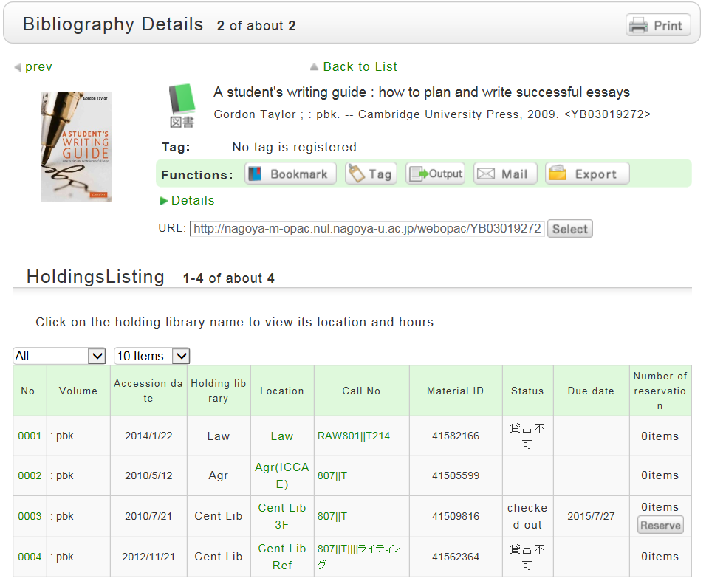
Information on the Book in OPAC
☟There are 4 copies available within NUL and 2 of them are in the Central Library
[Location]
Library and Area
(“Cent Lib ***”
= Central Library)
Click on Location to view map
Take notes of both！ （Important for finding the book）
[Call number]
Book’s arrangement and subject
Labeled on the spine of the book
Notes:
【This slide explains detailed info screen. You can explain on actually opened screen】
●Confirm the title and author of the book, is it the book you are looking for?
●The library holds 4 copies of this book, two are in Central Library
●Make sure to take a note of location and call no. If you don’t do this you cannot find the book
●Location is quite approximate. Cent. Lib means Central Library. Click location and map will be shown
●Call No. is the location of the book on the bookshelf, which is indicated as spine label of the book （demonstrate real book）
○If the location is not Cent. Lib. **, it belongs in one of the departmental libraries
○First part of call no. is main subject of the book

Slide 14
Practice 1： Let’s Search for a Book in OPAC!
Search the following book in OPAC and check the location.
“Theoretical ecology : principles and applications” 3rd ed. edited by May, Robert M., McLean, Angela R.
(Oxford University Press, 2007)
Notes:
【The time for practice is 5mins., but if everyone solved it faster you can finish earlier. Give support by going round and checking if search screen is opened or if there are any questions】
Practice 1: Searching for books
○Can you already distinguish if it is a book?
【→Let everyone search. When almost everyone reached details screen, explain how to read it】
●Carefully check information on holdings
●Make sure to take memo of ‘Location’ and ‘Call no.’
Location: Cent Lib 3F
Call no.: 468||M
○‘checked out’ means that someone has already borrowed it .
You can reserve it if you want to read it as soon as possible.

Slide 15
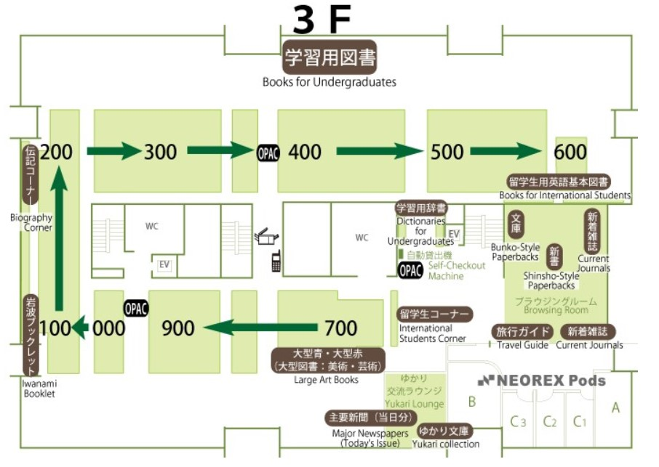
Cent lib 3F =
Central Library. Books for Undergraduates(3F)
Notes:
Central library 3rd floor.
○There are many locations beginning “Cent Lib”, such as ‘Cent Lib
Intnl’, ‘Cent Lib 3F’.
●The location differs according to types of books.
Books for undergraduates locate 3rd floor.
It is important for finding books not only ‘Call no’ but ‘Location’.

Slide 16
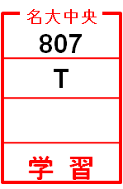
Arrangement of Books
Order of Call number
Classification number → author’s symbol
The location differs according to types of books
For undergraduates：3rd floor / For researchers：1st・4th floor / Reference books：1st・2nd floor
800
Classification No. →
Author’s symbol →
Info about Vol.&
Bookshelf etc →
Location →
Books placed near
= close topic
810
Notes:
【Arrangement scheme】
●Books are arranged by ‘Call No’.
Books are first arranged by classification number (first row) and
within the same number they are arranged by author’s symbol
(second row).
●Classification number (first row of Call No) shows the topic of the
book, so books located near are on the same topic (have the same
number).
●The location differs according to types of books.

Slide 17
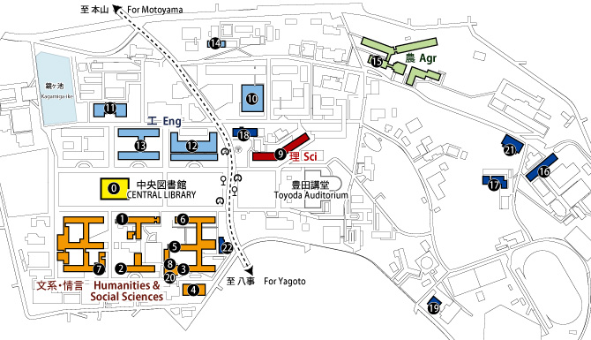
Map of Nagoya University Libraries
[Higashiyama campus] 0 Central Library 1 Humanities 2 Education 3 Law 4 Asian Law 5 Economics
6 Economic Research Center 7 Informatics and Languages 8 GSID 9 Science 10-14 Engineering
15 Bioagricultural 16 ISEE1 17 ISEE2 18 Info. Tech. 19 Health, Physical Fitness and Sports 20 Inst. Int’l Edu. & Exch. 21 Pharmaceutical Sci. 22 Gender Research
[Tsurumai Campus] Medical Library [Daiko Campus] Library of Health Sciences (Medical Library)
Notes:
Higashiyama Campus library map
○Departmental libraries have more specialized materials than Central Library.

Slide 18
Example
１
Taylor, Gordon. A student's writing guide :
how to plan and write successful essays.
Cambridge University Press, 2009.
a book？
a journal？
２
Scheiber, H. “From Science to Law to Politics:
an Historical View of the Ecosystem Idea and
Its Effect on Resource Management.”
Ecology Law Quarterly. 24.4 (1997): 631-652.
Notes:
【Example: Journal】
Is this a book or a journal? Check if participants can distinguish.
● “From Science…” is the title of the article
● “Ecology Law Quarterly” is the title of the journal
● When searching in OPAC, you cannot search by the article title, author, publication year, volume.
Make sure to search by journal title

Slide 19
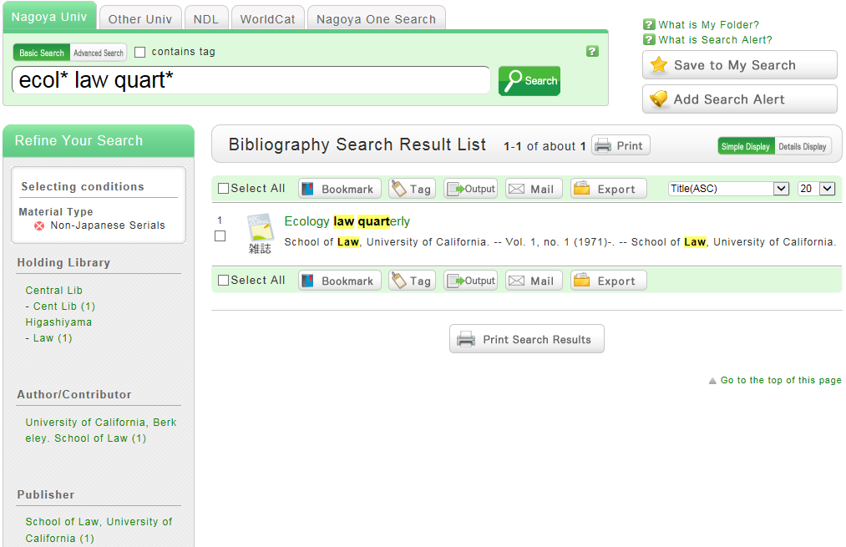
Searching for Journals in OPAC
Search by ‘Journal title’
×article title
×author
×publication year
Click on the title for details
Refine by Material Type
You can also narrow down by Holding Library, Publication year, Language etc.
Notes:
【demonstrate on actual screen】
●Search screen: enter keywords in keyword field and click search button
●Search results screen: materials matched with entered keywords are displayed.
Information on holdings of those materials can be checked by clicking on the title

Slide 20
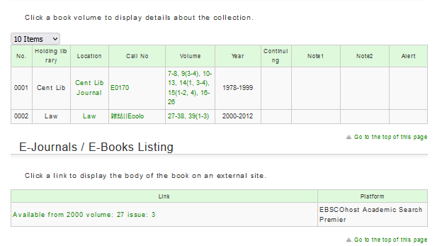
Information on the Journal in OPAC
☟The journal is located in two libraries in NUL, one is Central Library
Make sure to check！
※The existing volumes are displayed here
Note that library may not hold all volumes!
Clicking the volume will show you holding information
Displayed when the e-Journal is available
Notes:
【Demonstrate until the details screen, then explain on slide】
●This journal is located on 2 libraries in NUL, one is Central Library
○Holding information of journals is different from the one of books.
It tells us which issues and volumes are available.
●Even if journal is available, the volume you need may not be available.
Make sure to check not only location but year/volume as well
●”Accession continuing” means that this journal is currently being subscribed
●Clicking the volume number will show you the holding information and arrival information.
●If the full text is available the link to e-Journal will be displayed.

Slide 21
Practice 2: Let’s Search for a Journal in OPAC!
Search for the following article in OPAC and check the location.
Shimomura, Osamu, Frank H. Johnson, and
Yo Saiga. 1962. "Extraction, Purification and Properties of Aequorin, a Bioluminescent Protein from the Luminous Hydromedusan,Aequorea".
Journal of Cellular and Comparative Physiology.
59 (3): 223-239.
Notes:
【The time for practice is maximum 5 mins, but if everyone answered the questions, can be finished earlier.
Go around and check if search screen is opened or give support if there are any questions】
○Which one is the journal title? Do any participants search by the article title?
【Even if explained, it can be often mistaken, explain repeatedly if needed】
●When searching for journal too many result was returned, you can check ‘Serials’ in the material type to refine search
【→Let everyone search. When almost everyone reached details screen, explain how to read it】
●Check the location
・Location: Sci Biol (Year)Volume: (1938-1965)11-14, 15(3), 45-66
・Location: Cent Lib Journal (Year)Volume: (1955-1965)45-66
●Check carefully if needed volume is available with each location.

Slide 22
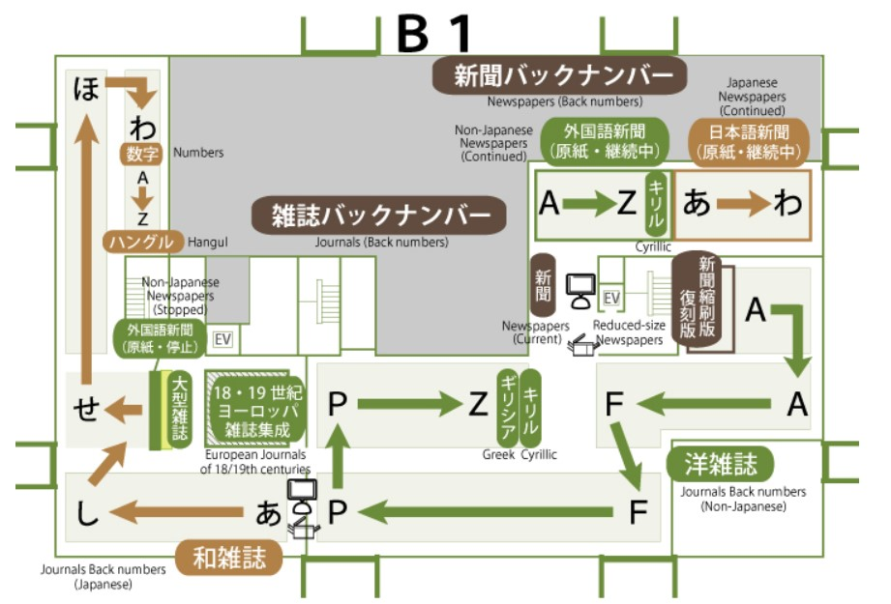
Cent Lib Journal = Central Library. Journals
(Current 3F / Back numbers B1F)
Notes:
Floor map of the Central Library （journals）
○The location differs according to publication year.
Back numbers are located on the basement.
Current issues are on the 3rd floor.

Slide 23
Arrangement of Journals
Alphabetical order (Japanese journals in kana order)
The location differs according to publication year
Current year issues: 3F
Previous issues: B1
A
Same journals are arranged by publication year
B
Journals cannot be borrowed →Make a copy
Notes:
●In each location, journals are divided between non-Japanese and
Japanese titles
●Non-Japanese journals are arranged in alphabet order, Japanese
journals in kana order
○Within the same journals they are arranged by volume no. and
publication year

Slide 24
Using the materials
Books for undergraduates
Books for researchers
Language learning materials, audio-visual items
Journals
Reference Books
Other items labeled “in library use only”
Can be borrowed
Cannot be borrowed
… Make a copy
Notes:
●There are materials which can be borrowed and which cannot be borrowed.

Slide 25
If You Cannot Find Materials
Search again, check the location again
Change/Check keywords (misspell, different words,…)
Incorrect location
Use materials in other libraries
Basics are the same as materials in the University
Search → Find → Use
Visit: in some cases inquiry in advance is required
Order: Copy of articles/ part of books, book itself
When order a book, pay postal fees
→Ask Interlibrary Loan Desk, or your departmental library
Allow enough days!
Notes:
If you search in OPAC and no results
●First, check for misspellings.
OPAC does not automatically correct misspellings, as Google
○If the book in search results but you could not find it, check
if location is correct.
If cannot find it either, ask advice at Service Desk.
●If a book is not available in NUL, search if it is available in other
libraries.
As in NUL, search where the book is available before using it.
○You can visit the library or order a book or copy of the article.
Ask Interlibrary Loan Desk of the Central Library or your
departmental library
○It will take some time for inquiry or order.
Do not order it just before the deadline of report, plan extra
of time for more than one week.

Slide 26
When you need help
Support Desk
Opening hours: weekdays 3:00 pm - 7:00 pm
Graduate student staff support your study
How to search materials, writing study plan, PC troubles, etc.
Reference Desk
Opening hours: weekdays 8:30 am - 5:00 pm
How to search electronic resources and obtain materials
Service Desk at your departmental library
Notes:
●If you have problems in searching for materials, using library ask these desks.
●Response times may vary because of new coronavirus infection control measures, so it is recommended to check the situation on the website before visiting the Library.

